Slide 1
Xenon UI - Introduction
Colin Gu
Jan 2017

Slide 2
Agenda
1 | What it has to offer?
2 | Demo
3 | UI Architecture
4 | Tech Stack
5 | How can you build your own UI?

Slide 3
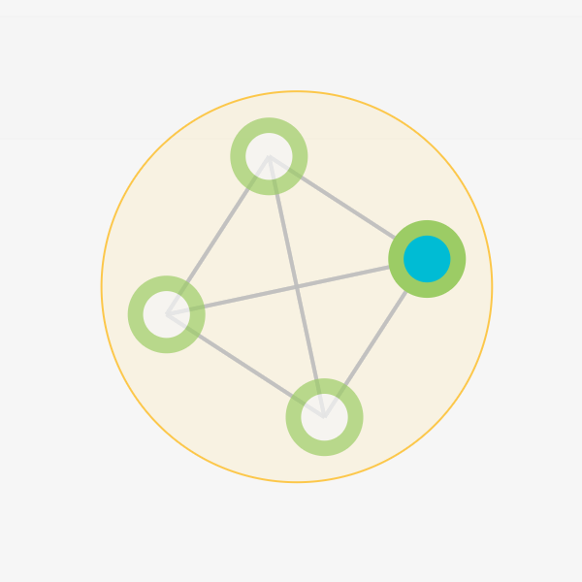
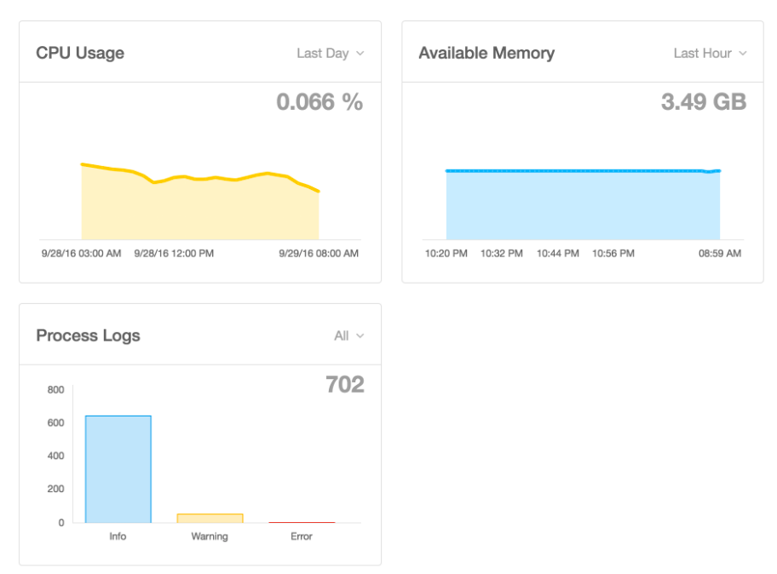
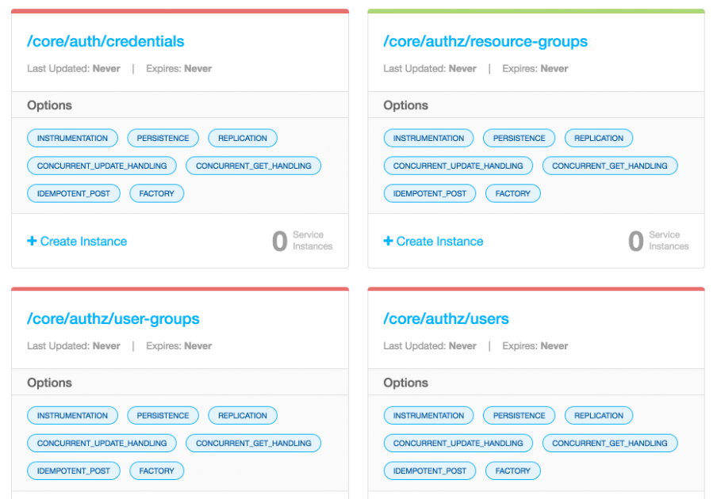
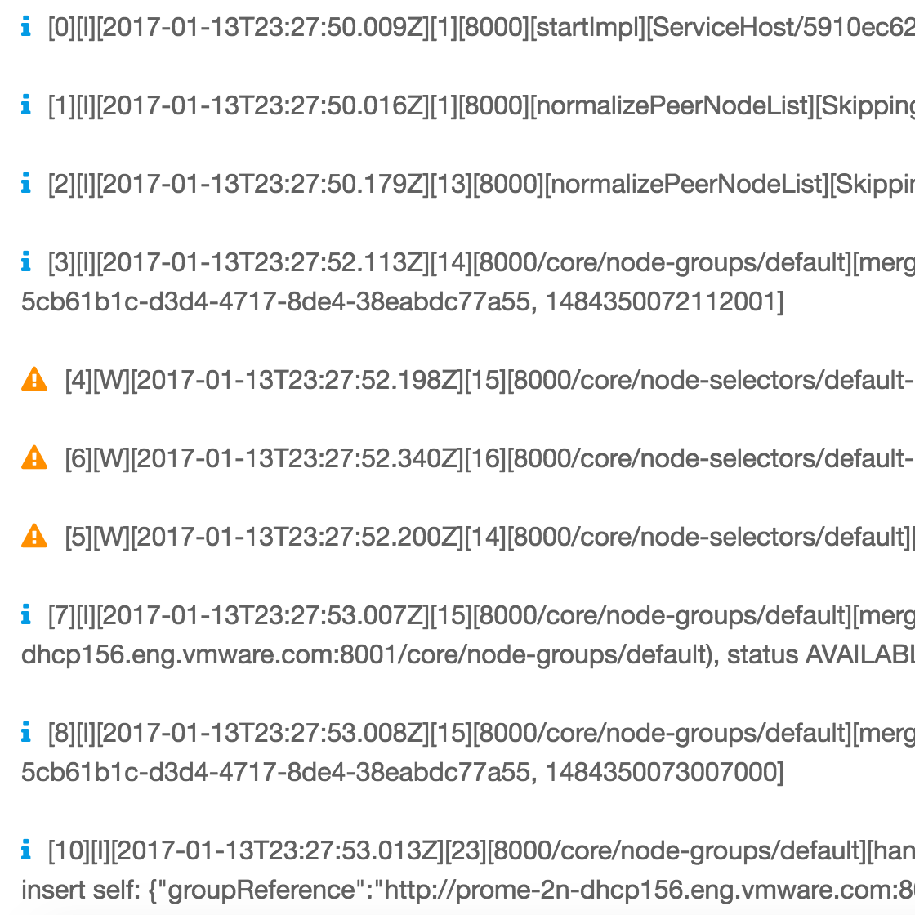
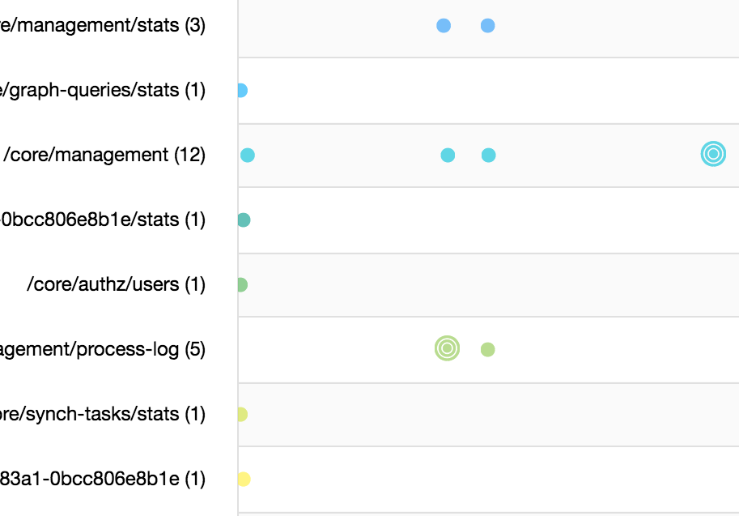
What it has to offer?

Slide 4
DEMO

Slide 5
UI Architecture
Xenon UI
Service UI
Query UI
Operation Tracing UI
…
UI-level Services
Documents
Xenon Stateless Service (to serve UI)
Xenon

Slide 6
Tech Stack
Xenon UI
Angular 2
Angular-seed-advanced
Bootstrap 4
D3
Chart.js
lodash

Slide 7
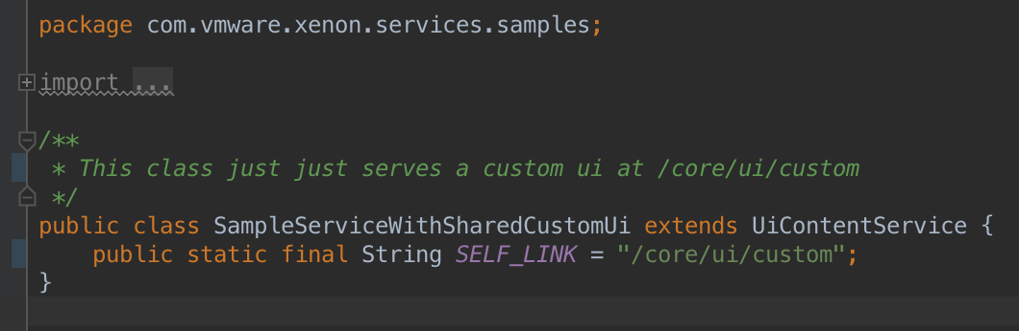
How can you build your own UI?
Step 1. Create a new service for UI, which extends UiContentService
Specify a location to SELF_LINK to service static resources

Slide 8
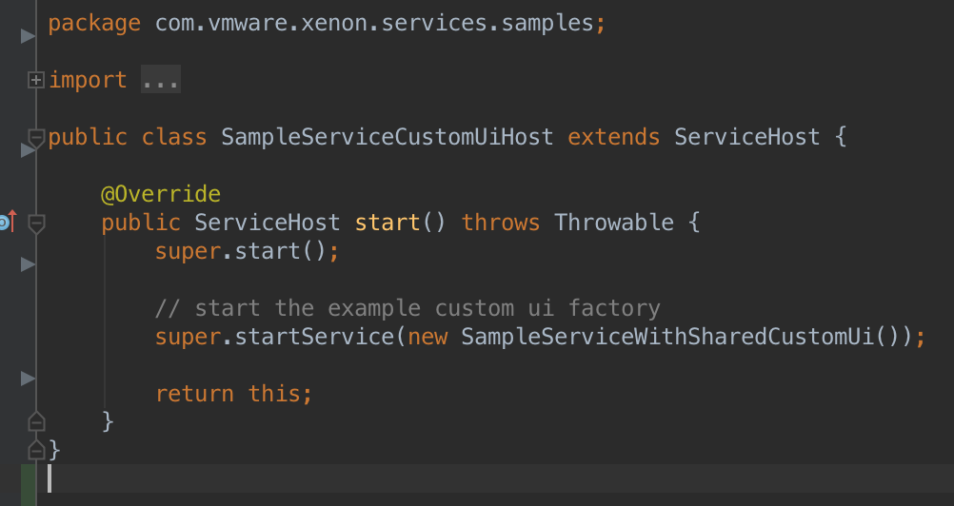
How can you build your own UI?
Step 2. Start the UI service in the host

Slide 9
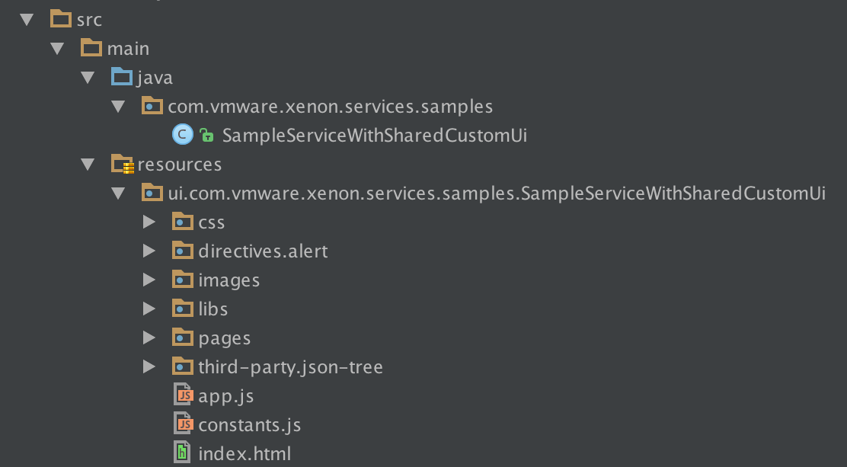
How can you build your own UI?
Step 3. Place the UI resources under the resources/ui/ folder
Need to have the same package name + the class name as your UiService
Must have an index.html under the root of the package

Slide 10
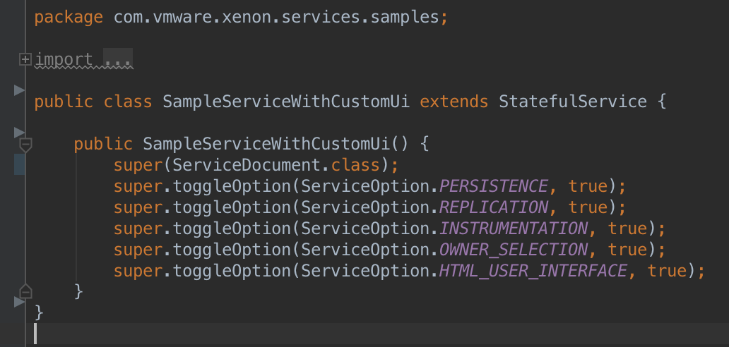
How can you build your own UI?
Step 4. Turn on ServiceOption.HTML_USER_INTERFACE if you are not extending UiContentService
Set to true within constructor

Slide 11
How can you build your own UI?
Building UI on Single Page Application(SPA) frameworks
Use hash location strategy
Any path beyond /core/ui/custom/# will be taken over by the UI’s routing mechanism
Put the production build artifacts under the resource package
Source code can live elsewhere
Consider using resourceSandbox option to speed up development
Make Xenon serves the UI resource files from disk rather than the compiled .jar file
java -jar target/xenon-samples-1.3.5-SNAPSHOT-jar-with-dependencies.jar --resourceSandbox=src/main/resources/
Or using a proxy server…
Xenon UI is served from a Node.js server during development time
UI
Node Server
Proxy
Xenon Host

Slide 12
Documentations
Xenon UI - Github Wiki
Hosting Custom UI on Xenon-based Service - Github Wiki
Ask Xenon Bot on Slack - @xenon-bot

Slide 13

Q & A

